Slide 1
Swapping

Slide 2
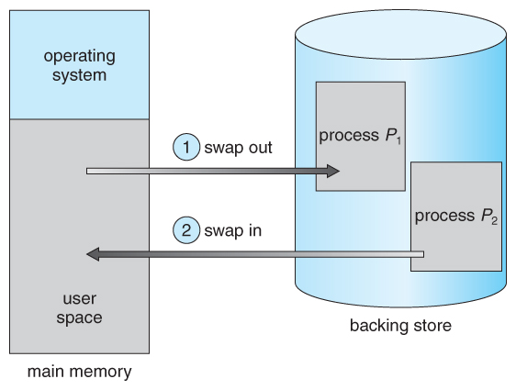
Standard Swapping

Slide 3
Swapping
Three parts of swapping algorithm:
Managing space on the swap device,
Swapping processes out of main memory, and
Swapping processes into main memory
Swap device is a block device in a configurable section of a disk
Kernel allocates space for files one block at a time, it allocates space on the swap device in groups of contiguous blocks
Fragmentation

Slide 4
Managing space on the swap device
Data structure
Map, in-core table
A map is an array where each entry consists of an address of an allocatable resource and the number of resource units available there
Allow a first-fit allocation of contiguous "blocks" of a resource

Slide 5
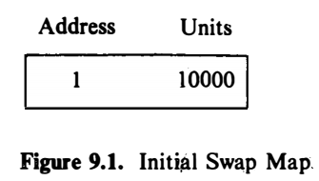
Managing space on the swap device
A group of disk blocks,
Address as a block offset from the beginning of the swap area

Slide 6
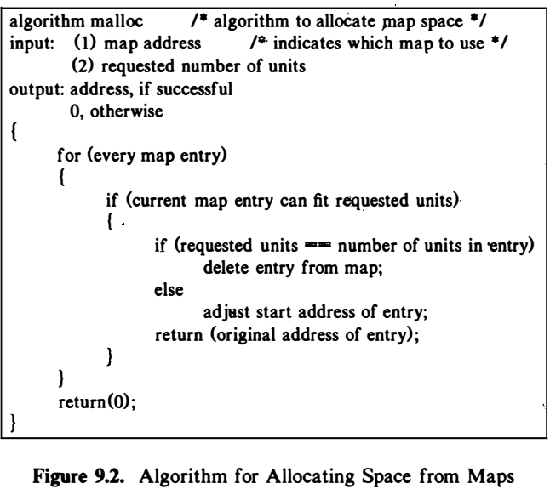
Managing space on the swap device

Slide 7
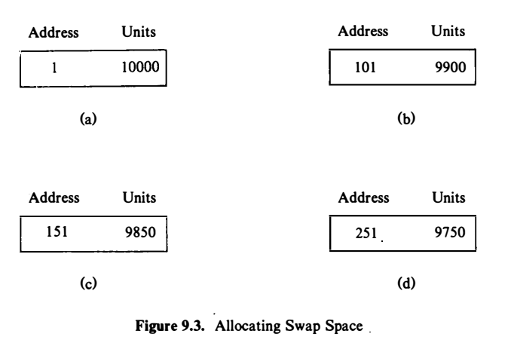
Managing space on the swap device
Sequence of swap map configurations, after allocating:
100 units,
50 units,
100 units.
The kernel adjusts the swap map to show that the first 250 units have been allocated, and that it now contains 9750 free units starting at address 251

Slide 8
Managing space on the swap device
When freeing resources, three cases are possible:
The freed resources completely fill a hole in the map
The kernel combines the newly freed resources and the existing (two) entries into one entry in the map.
The freed resources partially fill a hole in the map.
The kernel adjusts the address and units fields of the appropriate entry to account for the resources just freed.
The freed resources partially fill a hole but are not contiguous to any resources in the map.
The kernel creates a new entry for the map and inserts it in the proper position

Slide 9
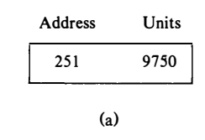
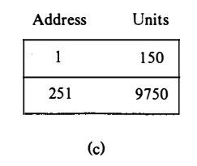
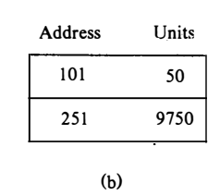
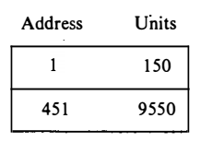
Managing space on the swap device
If the kernel then frees 100 units of the swap resource starting at address 1
if the kernel frees 50 units of the swap resource starting at address 101
Suppose the kernel now requests 200 units of swap space

Slide 10
Swapping Processes Out
Kernel swaps a process out if it needs space in memory, scenario could be:
The fork system call must allocate space for a child process,
The brk system call increases the size of a process,
A process becomes larger by the natural growth of its stack,
The kernel wants to free space in memory for processes it had previously swapped out and should now swap in

Slide 11
Swapping Processes Out
It is not necessary that the kernel write the entire virtual address space of a process to a swap device.
It copies the physical memory assigned to a process to the allocated space on the swap device, ignoring unassigned virtual addresses.
When the kernel swaps the process back into memory, it knows the virtual address map of the process, so it can reassign the process to the correct virtual addresses.
The kernel eliminates an extra copy from a data buffer to physical memory by reading the data into the physical memory locations that were previously set up to conform to the virtual address locations.

Slide 12
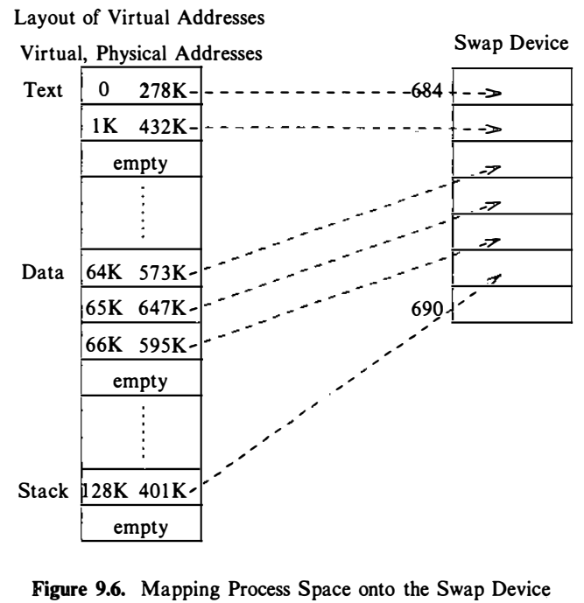
Swapping Processes Out

Slide 13
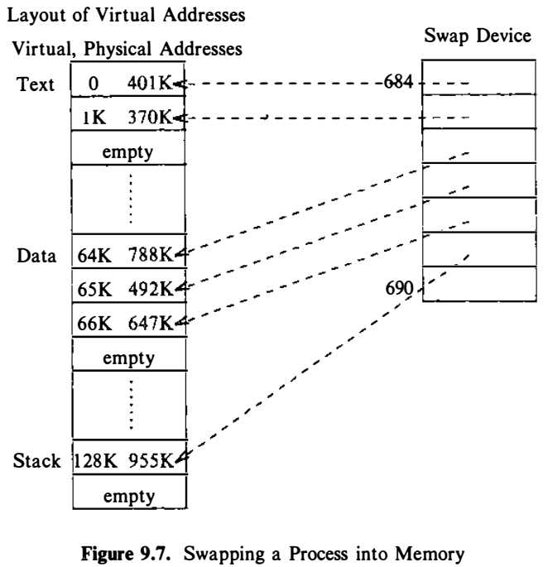
Swapping Processes Out

Slide 14
Swapping Processes Out
Theoretically, all memory space occupied by a process, including its u area and kernel stack, is eligible to be swapped out, although the kernel may temporarily lock a region into memory while a sensitive operation is underway.
Practically, however, kernel implementations do not swap the u area if the u area contains the address translation tables for the process.

Slide 15
Fork swap
The parent process found enough memory to create the child context.
Otherwise,
The kernel swaps the process out without freeing the memory occupied by the in-core (parent) copy.
When the swap is complete, the child process exists on the swap device; the parent places the child in the "ready-to-run" state and returns to user mode.
Since the child is in the "ready-to-run" state, the swapper will eventually swap it into memory, where the kernel will schedule it; the child will complete its part of the fork system call and return to user mode.

Slide 16
Expanded Swapping
When needs more memory than is currently available
It reserves enough space on the swap device to contain the memory space of the process, including the newly requested space.
Then, it adjusts the address translation mapping of the process to account for the new virtual memory but does not assign physical memory (since none was available).
Finally, it swaps the process out in a normal swapping operation, zeroing out the newly allocated space on the swap device

Slide 17
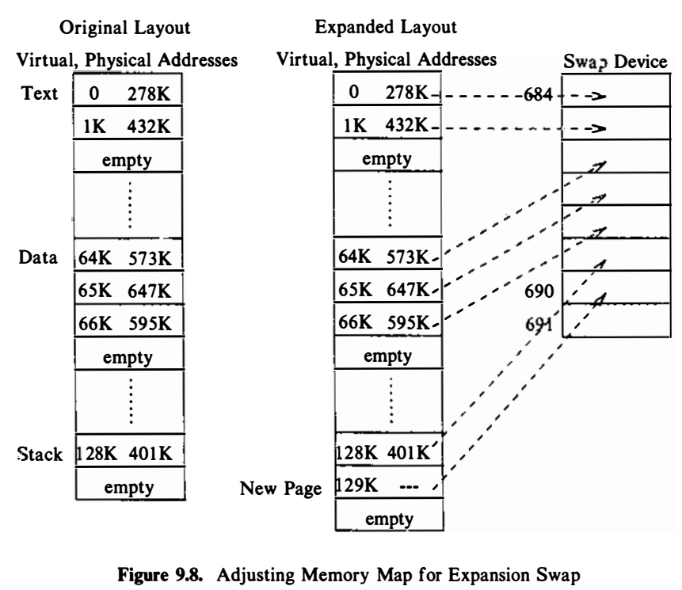
Expanded Swapping

Slide 18
Swapping Process in
Process 0: swapper
Works infinitely
Sleeps
Periodically wake-up
Works in kernel mode

Slide 19
Swapping Process in
If the swapper successfully swaps in a process, it searches the set of "ready-to-run but swapped out" processes for others to swap in and repeats the above procedure.
One of the following situation eventually arises:
No "ready-to-run" processes exist on the swap device
The swapper finds an eligible process to swap in but the system does not contain enough memory
The kernel swaps out sleeping processes rather than those "ready to run"

Slide 20
Swapping Process in
Swap out
The choice of which sleeping process to swap out is a function of the process priority and the time the process has been in memory.
If there are no sleeping processes in memory, the choice of which "ready-to-run" process to swap out is a function of the process nice value and the time the process has been in memory.

Slide 21
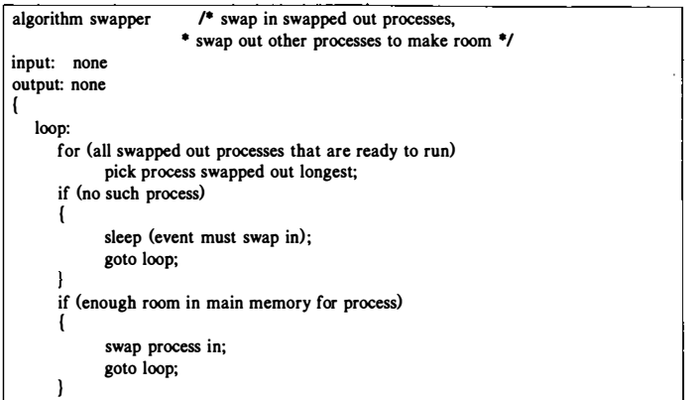
Swapping Algo: Swapper

Slide 22
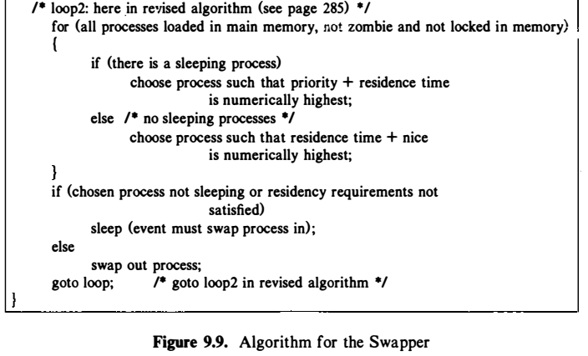
Swapping Algo: Swapper

Slide 23
Swapping Process in
A "ready-to-run" process must be core resident for at least 2 seconds before being swapped out, and
A process to be swapped in must have been swapped out for at least 2 seconds.
Swapper sleeps, if no process to swap in or out

Slide 24
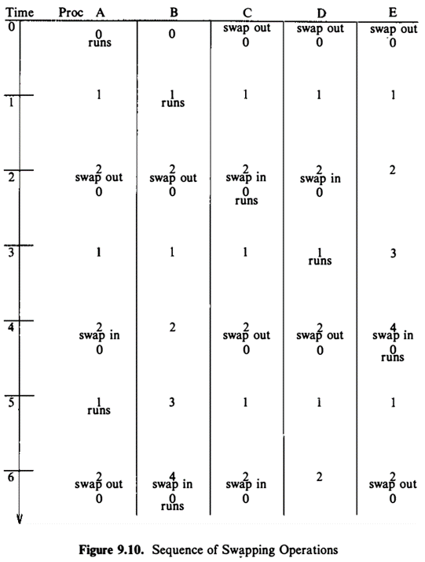
Swapping Process in
Assume that all processes A, B, C, D and E are CPU intensive and that they do not make any system calls; hence, a context switch happens only as a result of clock interrupts at 1-second intervals.
The processes are the same size and the system can contain at most two processes simultaneously in main memory.

Slide 25
Swapping Process in: Issues
Swaps out a process only to make room for a process being swapped in, it may swap out a process that does not provide enough memory for the incoming process.
If the swapper sleeps because it could not find enough memory to swap in a process, it searches again for a process to swap in although it had previously chosen one.
If the swapper chooses a "ready-to-run" process to swap out, it is possible that the process had not executed since it was previously swapped in.
Thrashing

Slide 26
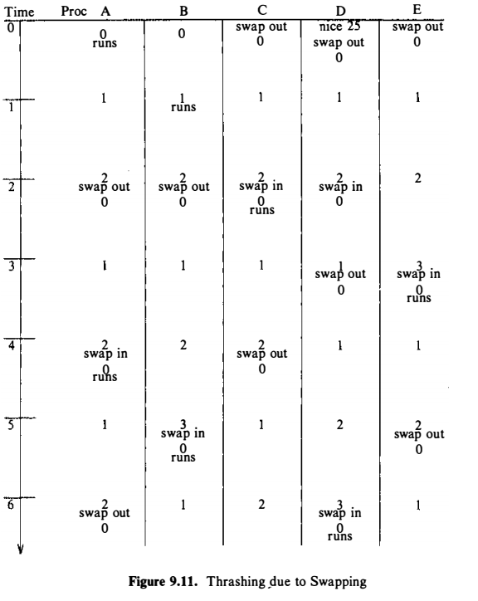
Swapping Process in: Issues
Example
Nice value of D is 25
The kernel swaps in process D at the 2-second mark,
schedules process C, and then swaps out process D at the 3-second mark in favor of process E (because of the interaction of the nice value) even though process D had never run.

Slide 27
Swapping Process in: Issues
If the swapper attempts to swap out a process but cannot find space on the swap device, a system deadlock could arise if the following four conditions are met:
All processes in main memory are asleep,
All "ready-to-run" processes are swapped out,
There is no room on the swap device for new processes, and
There is no room in main memory for incoming processes.

Slide 28
Reference
The Design of the UNIX Operating System, by Maurice J. Bach

Slide 29
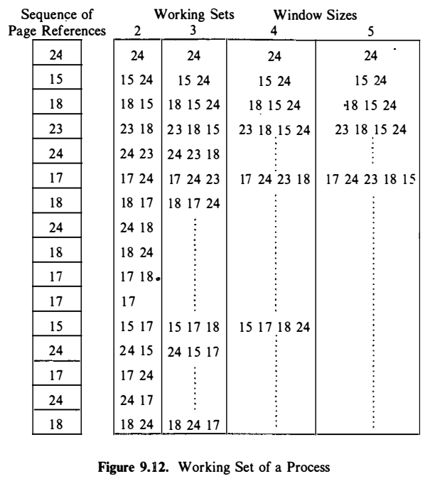
DEMAND PAGING
Locality
Working set

